Slide 1
Pub/Sub exercises using MQTT
23/02/2024
Notes:
Change log:
22/02/2024: initial version
23/02/2024: included how to stop mosquitto & shorter version of hands-on task #3

Slide 2
Lab content
Get familiar with MQTT
Run pub/sub and broker components locally
Add meaningful topics and fanout exchange
A closer look at the fog and edge parts (broker & local clients)
Separate the fog and edge from the cloud component

Slide 3
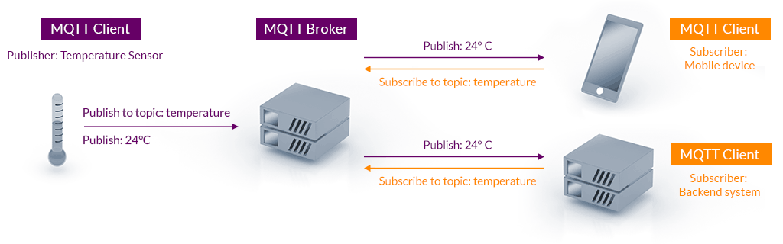
1. Components of MQTT: Pub/Sub + broker

Slide 4
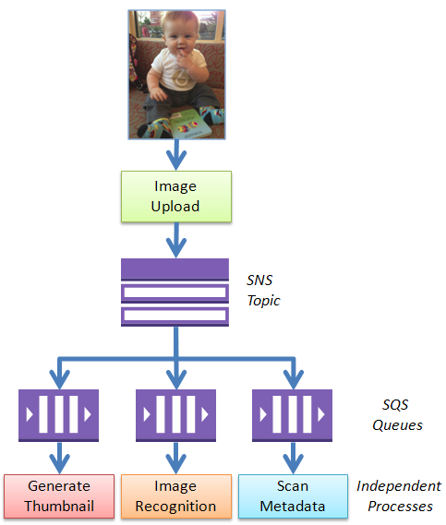
1. Topics & Queues in AWS

Slide 5
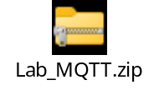
2. Hands-on using amqtt
1. Install dev environment
sudo apt update
sudo apt update
sudo apt install python3.14 python3.14-venv
python3.14 -m venv ~/mqtt_env
source ~/mqtt_env/bin/activate
2. Install MQTT software
python -m pip install --upgrade pip
python -m pip install amqtt

Slide 6
2. Components of MQTT: Pub/Sub + broker
1. Start the broker
2. Subscribe to topic temperature
3. Publish data topic temperature

Slide 7
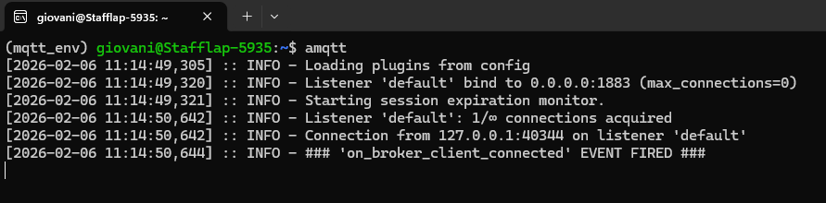
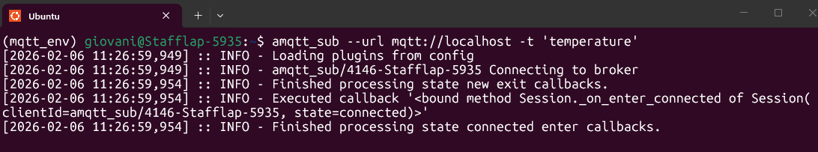
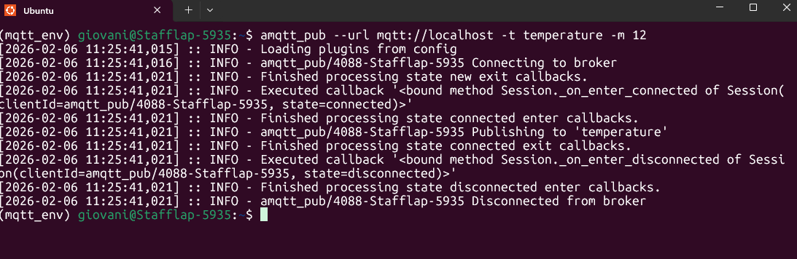
2. Components of MQTT: Pub/Sub + broker
1. Start the broker: amqtt
2. Subscribe to topic temperature:
amqtt_sub --url mqtt://localhost -t 'temperature'
3. Publish data topic temperature
amqtt_pub --url mqtt://localhost -t temperature -m 12

Slide 8
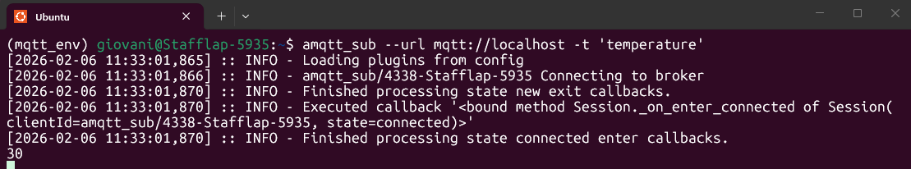
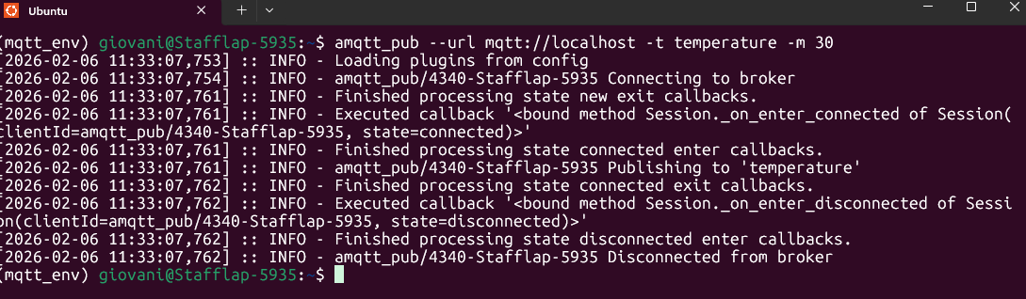
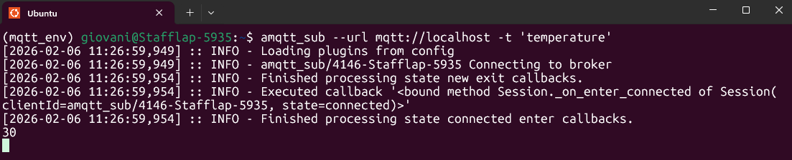
3. Hands-on using amqtt
Try the 1-to-many
  Multiple subscribers
  One publisher

Slide 9
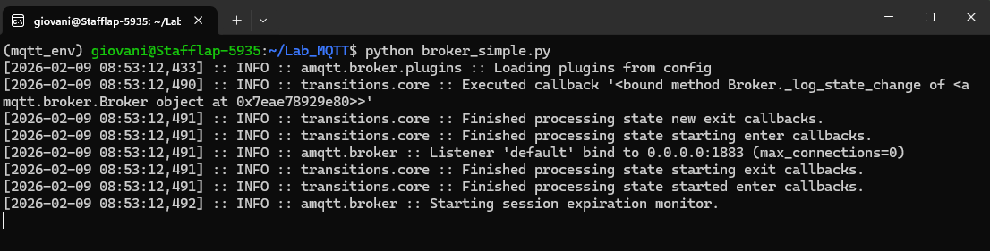
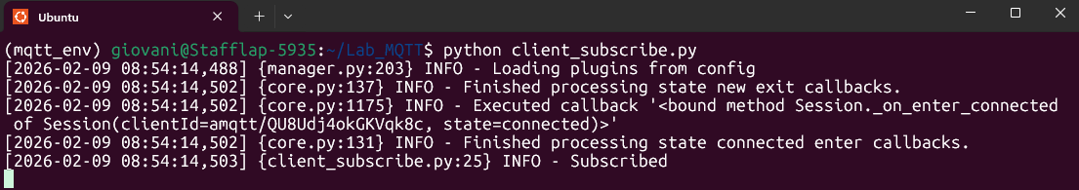
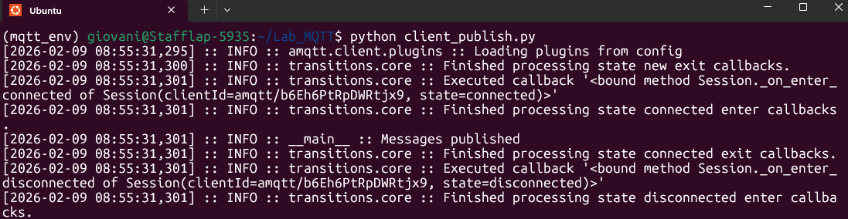
3. How does the code look like?
1. Start the broker: broker_simple.py
2. Subscribe to topic temperature:
python client_subscribe.py
3. Publish data topic temperature
python client_publish.py

Slide 10
Hands-on 4: code the fog & edge architecture
Edge (Local sensors)
Fog (Local broker)
Core (Cloud backend)

Slide 11
Look for
What’s MQTT default port?
Does it use TCP or UDP?
Name a few implementations of MQTT
What are the options regarding Quality of Service (QoS)?
What are the implications of QoS on network overhead?

